Slide 1

Compressed Sensing
Corso di Laurea Magistrale in Ingegneria Biomedica Dipartimento di Ingegneria dell’Informazione, Università di Pisa
Giuseppe Valvano
giuseppe.valvano@for.unipi.it
Lezioni per il corso “Metodi per l’analisi dei Segnali Multidimensionali”
Prof. Luigi Landini
AA 2015-2016

Slide 2
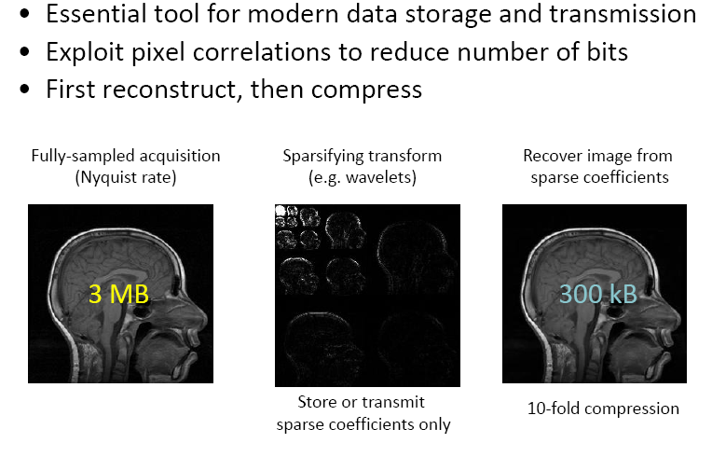
Image compression

Slide 3
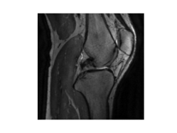
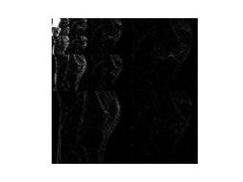
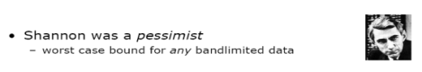
Compression chain
Spectrum Sparsity
Signal chain
Sampling
Fourier transform
Acquisition
Processing
Compression/Storing
Source
Wavelet sparsity
MR chain
K-space acquisition
Inverse Fourier transform
Wavelet transform

Slide 4
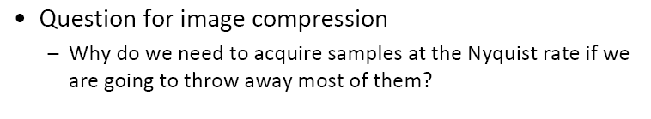
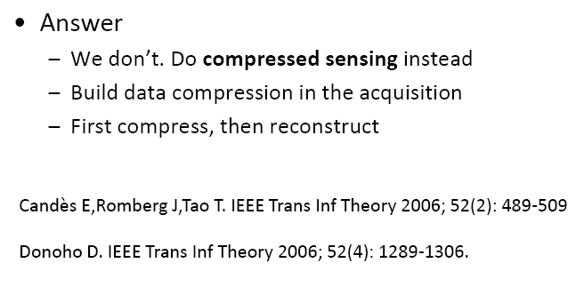
Compressed sensing

Slide 5
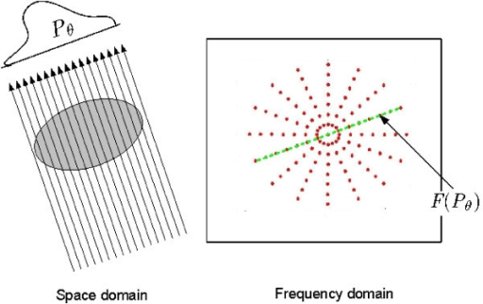
Conventional sampling Sampling as linear projection
Typically, each point in the K-Space is a Projection of the object (one row of the matrix A)
Compressed sensing (compression during acquisition) reduces the number of projections, thus reducing the acquisition time.

Slide 6
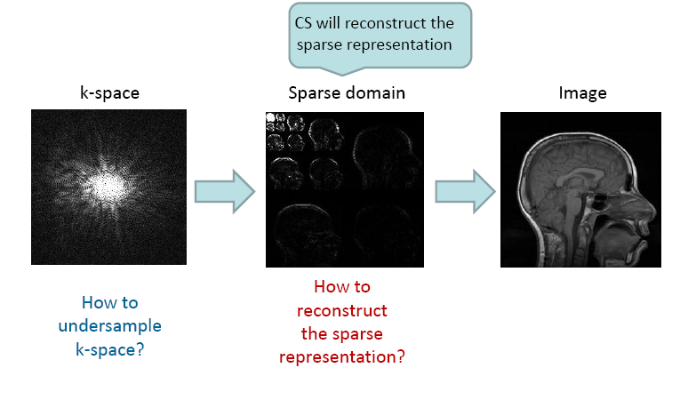
Compressed sensing
Undersampling the k-space
1?
2?

Slide 7

Dense to sparse relationship
Data
Trnsformation
Matrix
Sparse domain
y
=
A
x
=
A
Frequency sparsity
=
A
Wavelet
sparsity
A è diversa nei due casi

Slide 8
Where to undersample?
We must acquire the signal in a “dense” domain (time for spectrum sparsity / K-space for image-wavelet sparsity) using an undersampled acquisition matrix to reduce the samples number.
…in the time domain for sparsity in the spectrum domain
…in the K-space domain for sparsity in the wavelet domain

Slide 9
Examples of Undersampled Acquisition Matrix
Frequency sparsity: A = subset of rows of F^{H}
Data
Undersampled
Acquisition
Matrix
Sparse domain
y
=
A
x
Wavelet sparsity: B = subset of rows of F
y
=
A
x
the acquisition and the sparse transformations must be almost uncorrelated
F = Fourier Matrix (Discrete Fourier transform)
F^{H} = Inverse Fourier Matrix
Ψ = Wavelet transform
Ψ ^{H} = Inverse Wavelet transform

Slide 10
1) How to Undersample: Equispaced undersampling
Equispaced undersampling leads to coherent aliasing
Blue: spectrum at Nyquist sampling

Slide 11
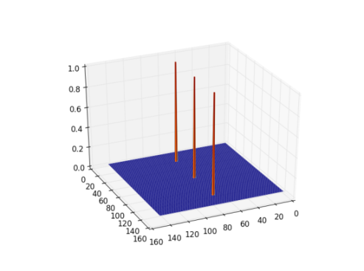
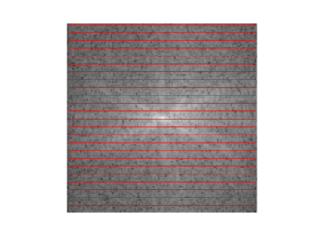
Equispaced undersampling PSF
K-Space
Point Spread Function (PSF)
defined in the image domain
Apply inverse FFT to the undersampling mask (red lines)
Regular undersampling in one direction
Undersampling mask

Slide 12

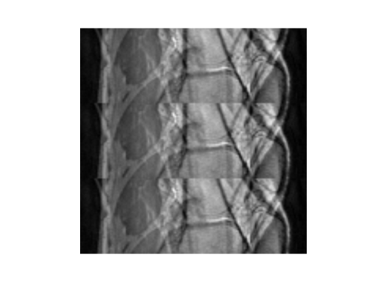

Image formation with equispaced undersampling PSF
Conv(.)
the PSF is convolved with the image
Coherent Aliased image
Since the PSF is convolved with the image, there should be a Toeplitz matrix that represents the PSF

Slide 13

Random undersampling

Slide 14
Random undersampling
Red: Inchoerent aliasing (much similar to the true spectrum)

Slide 15
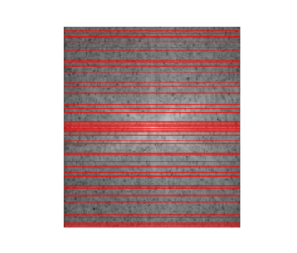
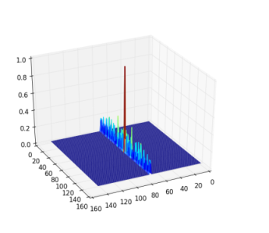
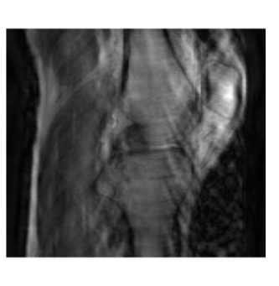
Random undersampling 1
Random undersampling leads to incoherent aliasing
K-Space
PSF
Image
Red: acquisition matrix
Acquisition Point Spread Function (PSF)

Slide 16
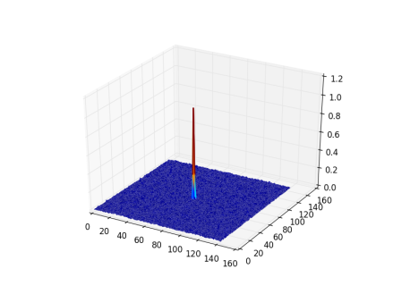
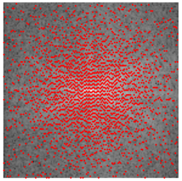
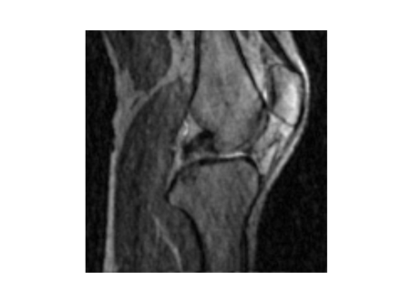
Random undersampling 2
Random undersampling leads to incoherent aliasing
K-Space
PSF
Image

Slide 17
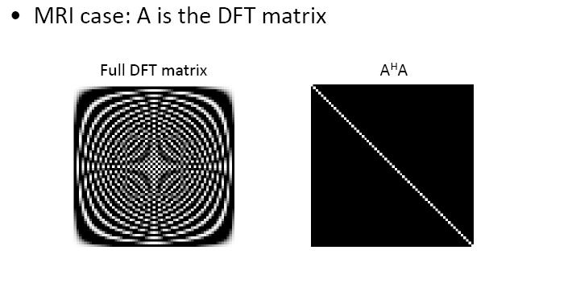
How to check incoherence?
A is a full acquisition matrix

Slide 18
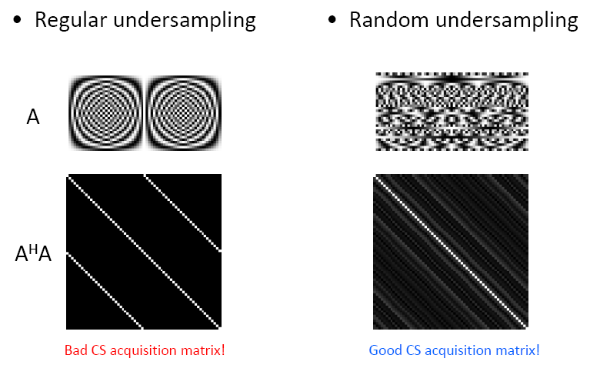
How to check incoherence?
Equispaced undersampling leads to high correlations between the columns of the Acquisition Matrix A.
Real(A)
Imag(A)

Slide 19
How to check incoherence?
Random undersampling
minimize the correlations in this matrix.
abs(A^{H}A)
Real(A)
Imag(A)

Slide 20
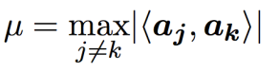
How to check incoherence?
So we should minimize the correlations between the columns of A.
A good way to characterize the matrix A is to evaluate the acquisition coherence:
This is equal to the max value of A^{H}A outside its main diagonal.

Slide 21
2) Reconstruction/Signal recovery
Chose, among all the solutions x consistent with the data y, the solution representable with less coefficients. Computationally convenient formulation (images):
Least squares term
Data consistency
Enforce
sparsity of x

Slide 22


Signal Recovery
Convex Optimization
Problem

Slide 23
Example of algorithm: Iterative Soft Thresholding (ISTA)

Slide 24
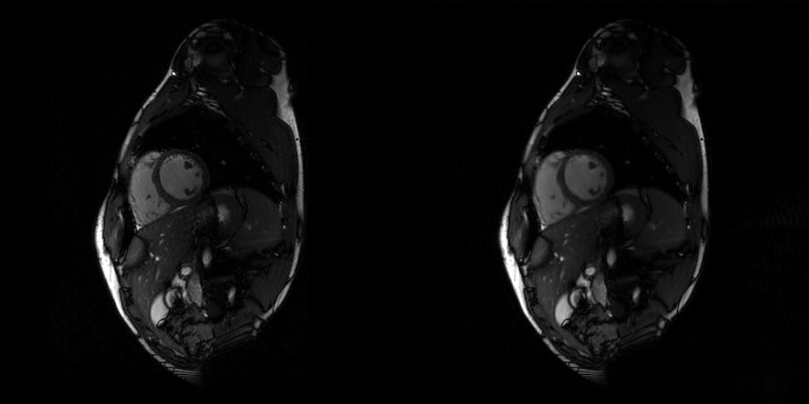
Examples: 2D cine MRI
4x Undersampled,
after CS reconstruction
Fully sampled

Slide 25
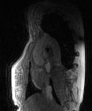
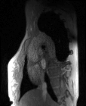
Examples: 4D flow MRI
Fully sampled
8x Undersampled,
after CS reconstruction
here, only one slice is shown

Slide 26
Applications
Magnetic Resonance Imaging:
reducing the scan time
improving the resolution (in time and in space)
Computer Tomography:
reducing the dose
Photo-Acoustic Tomography:
reducing the number of projections
EEG / ECG ultra low power sensing:
reducing the number of leads
reducing the amount of transferred data

